Slide 1
Lab #3

Slide 2
Binary search
Binary search is a fast search algorithm
This search algorithm works on the principle of divide and conquer
data collection should be in the sorted form.

Slide 3
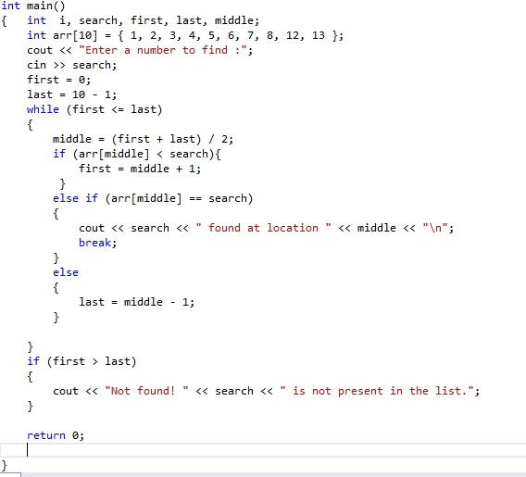

Slide 4
Lab Tasks
Write a program which uses Binary Search to search the elements 45. NUMBERS=[11,22,33,36,45,52,57,60,64,78]
Write a program which uses Binary Search to search the elements 52, and 33 and print it. NUMBERS=[10,20,33,36,47,50,59,60,64,78]

